Slide 1
BRANCH PREDICT10N ES 215 Project

Slide 2
1NTR0DUCT10N

Slide 3
What is Branch Prediction ?
Branch prediction is a method to reduce pipeline stalls caused by conditional branches and thus improving the overall performance of the processor [1].
Pipeline stalls are the delays in execution of instructions in order to resolve a hazard and due to this the processor cannot meet the demanding data access rate [2].
This issue can be solved by predicting the outcome of the conditional branch instruction.
When the actual branch instruction is resolved, the processor can continue executing instructions. This lessens the amount of pipeline stalls and increases the processor’s performance [2].
This whole process is known as Branch Prediction.
Not using branch prediction will force the processor to wait for the branch result and then continue execution of next instruction [1].

Slide 4
Branch prediction in terms of Computer Organization vs Computer Architecture
Organization
It is concerned with maximizing the processor’s performance while using simpler means and minimal hardware [3].
Architecture
It is concerned with the design of hardware components and algorithms capable of properly predicting the outcomes of conditional branches [3].

Slide 5
Types of Branch Prediction

Slide 6
Static Branch Prediction
Single Direction
Backwards Taken Forwards Not Taken
In this strategy, we assume the branch will always be taken/not taken. If the prediction is correct then the processor continues execution of instructions. If the prediction is wrong, then the fetched instructions are discarded and then executed again with correct prediction [4].
With this strategy, we assume branch is to be taken if the current value of the PC exceeds the branch target. And is supposed to be not taken if the branch target exceeds the current value of the PC. This is very useful in cases of loops where exiting the loop is done after repeating the loop multiple times [4].
There are some other types of static branch predictors like Profiling based branch predictors but the key idea remains the same [4].

Slide 7
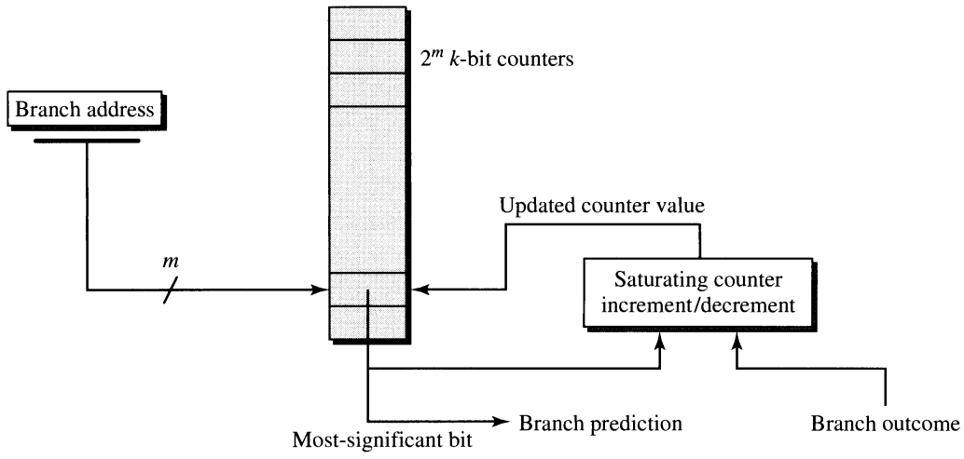
Dynamic Branch Prediction
Smith’s Algorithm
In this algorithm, we take m bits from branch address and make 2^{m} k bit saturating counters. The most significant bit of the corresponding counter gives the prediction, 0 for not taken and 1 for taken. Every time the branch is taken, we increase the counter by 1 and decrease by 1 when branch is not taken [5].
Figure 1 : : Smith Predictor with a 2^{m}-entry Table of Saturating k-bit Counters[5].

Slide 8
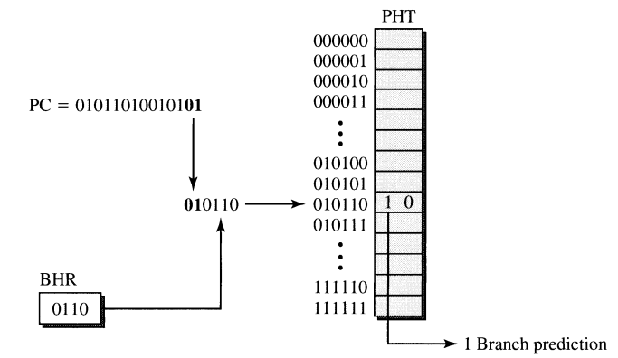
Dynamic Branch Prediction
Global History two Level Predictor
Global branch history is a concept that relates behaviour of branch to an earlier branch. The most recent outcomes are stored in Branch History register (BHR), which is a n bit shift register. These n bits are concatenated with last m bits of PC instruction to form an index. That index is searched in Pattern History table (PHT) among 2^{m+n} counters and the significant bit of the corresponding counter gives the prediction. 1 for taken and 0 for not taken [5].
Figure 2 : A global history 2 level predictor with 4 bit BHR[5].

Slide 9
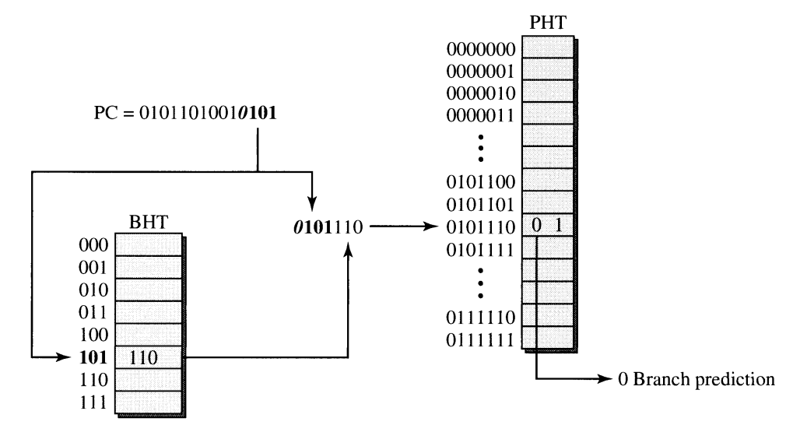
Dynamic Branch Prediction
Local History two Level Predictor
Local history contains previous results of current branch in contrast to Global history which has results of last several branches. A Branch History Table (BHT) is formed with 2^{m} BHRs; where m is the last m bits of PC instruction and the BHT is indexed. The bits from the m indexed BHR is concatenated after few bits from the PC instruction and the resulting index is searched in the PHT. The significant bit of the corresponding counter gives the prediction. 1 for taken and 0 for not taken [5].
Figure 3 : A local history 2 level predictor with 3 bit history length and 8 entry BHT[5].

Slide 10
Differences between newer and older Branch Prediction techniques
New Branch prediction techniques
These involve dynamic branch prediction methods such as Two level predictors, Hybrid predictors, Neural predictors, etc [5].
Accuracy is much higher (83.4 % to 97.5 % when using 2 history bits) [5].
More hardware components (such as counters and registers) are required [6].
Suitable method for more intricate processors [6].
New Branch prediction techniques
These involve static branch prediction methods like Single direction predictors, BTFNT predictors, profile based prediction etc [5].
Accuracy is less than that of newer techniques (55% to 80 % when branch was predicted always taken/not taken) [5].
No/very less hardware is required [6].
Apt choice for simple processors [6].

Slide 11
References
[1] D. A. Patterson, P. Alexander, and J. L. Hennessy, Computer organization and design : the hardware/software interface. Waltham, Ma: Morgan Kaufmann, 2012.
[2] “What is branch prediction?,” Educative: Interactive Courses for Software Developers. https://www.educative.io/answers/what-is-branch-prediction (accessed Apr. 03, 2023).
[3] “Differences between Computer Architecture and Computer Organization - GeeksforGeeks,” GeeksforGeeks, May 13, 2019. https://www.geeksforgeeks.org/differences-between-computer-architecture-and-computer-organization/
[4] A review of branch prediction schemes and a study of branch predictors ... (no date). Available at: https://www.researchgate.net/profile/Venkata-Mekala/publication/266891966_A_Review_of_Branch_Prediction_Schemes_and_a_Study_of_Branch_Predictors_in_Modern_Microprocessors/links/545ac9ed0cf2c46f6643898c/A-Review-of-Branch-Prediction-Schemes-and-a-Study-of-Branch-Predictors-in-Modern-Microprocessors.pdf. (Accessed: April 4, 2023).
[5] John Paul Shen and M. H. Lipasti, Modern Processor Design. Waveland Press, 2013.
[6] Branch prediction techniques used in pipeline processors : A Review (no date). Available at: https://acadpubl.eu/hub/2018-119-15/2/302.pdf (Accessed: April 4, 2023).

Slide 12
Additional Resources
We use these resources to learn about branch prediction. We would like to acknowledge the authors, publications for making our understanding better about the subject.
“Spring 2015 -- Computer Architecture Lectures -- Carnegie Mellon - YouTube,” https://www.youtube.com/playlist?\\list=PL5PHm2jkkXmi5CxxI7b3JCL1TWybTDtKq (accessed Apr. 04, 2023).
“Video 56: Bimodal Branch Predictors, CS/ECE 3810 Computer Organization” https://www.youtube.com/watch?v=Zeuc2PiXH8k (accessed Apr. 04, 2023).
D. A. Jimenez, “Piecewise linear branch prediction,” IEEE Xplore, Jun. 01, 2005. https://ieeexplore.ieee.org/document/1431572 (accessed Apr. 04, 2023).
Stallings, W. (2016) Computer Organization and Architecture: Designing for performance. Boston: Pearson-Prentice Hall.
Hennessy, J.L., Patterson, D.A. and Arpaci-Dusseau, A.C. (2007) Computer Architecture: A quantitative approach. Boston: Morgan Kaufmann.
J. Shen and M. Lipasti, “Fundamentals of Superscalar Processors.” Available : http://acs.pub.ro/~cpop/SMPA/Modern_Processor_Design_Fundamentals_of_Superscalar_Processors(PDFDrive).pdf

Slide 13
Anshul Choudhary Anushk Bhana Kaushal Kothiya
0UR TEAM

Slide 14

THANK Y0U

